Slide 1
Chapter 3 ~ Routing~
Gandeva Bayu Satrya, ST., MT.

Slide 2
Agenda
Router ???
Routing ???
Routing in IPv4…
Routing in IPv6…

Slide 3
Router as Computer
Describe the basic purpose of a router
Computers that specialize in sending packets over the data network. They are responsible for interconnecting networks by selecting the best path for a packet to travel and forwarding packets to their destination
Routers are the network center
Routers generally have 2 connections:
-WAN connection (Connection to ISP)
-LAN connection

Slide 4
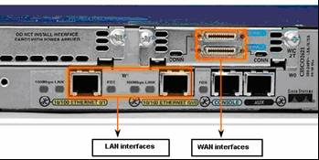
Router as Computer
Two major groups of Router Interfaces
LAN Interfaces:
Are used to connect router to LAN network
Has a layer 2 MAC address
Can be assigned a Layer 3 IP address
Usually consist of an RJ-45 jack
WAN Interfaces
Are used to connect routers to external networks that interconnect LANs.
Depending on the WAN technology, a layer 2 address may be used.
Uses a layer 3 IP address

Slide 5
Agenda
Router ???
Routing ???
Routing in IPv4…
Routing in IPv6…

Slide 6
Routing
The term Routing is used for taking a packet from one device and sending it through the network to another device on a different network.
Routers don’t really care about hosts they only care about networks and the best path to each network.

Slide 7
Routing Protocols

Slide 8
Basic Configuration
A basic router configuration should contain the following:
-Router name - Host name should be unique
-Banner - At a minimum, banner should warn against unauthorized use
-Passwords - Use strong passwords
-Interface configurations - Specify interface type, IP address and subnet mask. Describe purpose of interface. Issue no shutdown command. If DCE serial interface issue clock rate command.
After entering in the basic configuration the following tasks should be completed
-Verify basic configuration and router operations.
-Save the changes on a router

Slide 9
Configuring Interface
Configuring a FastEthernet interface
R1(config)# interface FastEthernet 0/0
R1(config-if)# description connection_to_INside
R1(config-if)# ip address 172.16.1.1 255.255.255.0
R1(config-if)# no shutdown
Configuring a Serial interface
R1(config)# interface Serial 0/0
R1(config-if)# description connection_to_OUTside
R1(config-if)# ip address 172.16.2.1 255.255.255.0
R1(config-if)# no shutdown
R1(config-if)# clock rate 9600

Slide 10
Agenda
Routing in IPv4…
Static Route

Slide 11
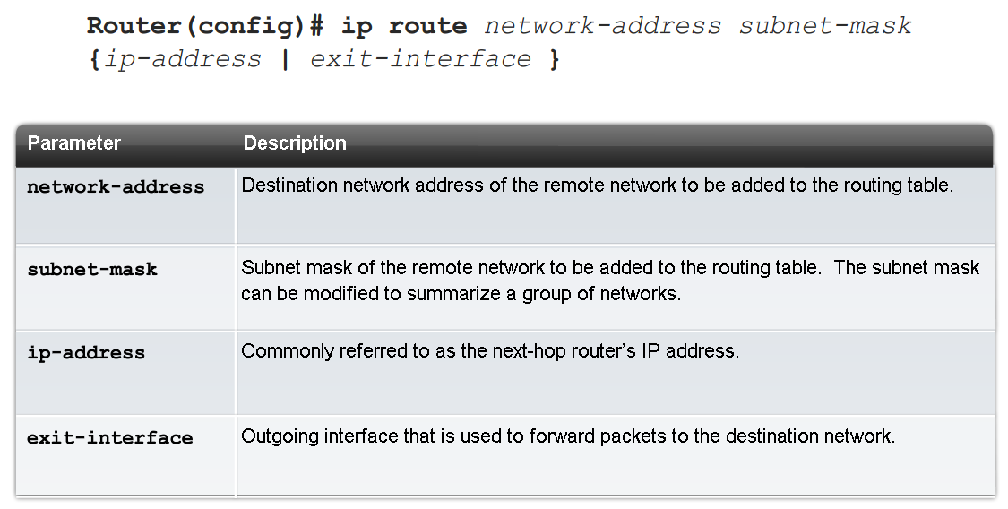
Configure STATIC
Static Routing is a manually configured, The Administrator is responsible for updating all changes by hand into all routers.

Slide 12
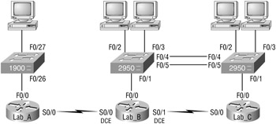
Exaple Static Routing

Slide 13
Router | Network Address | Interface | Address
Lab_A | 192.168.10.0 | fa0/0 | 192.168.10.1
Lab_A | 192.168.20.0 | s0/0 | 192.168.20.1
Lab_B | 192.168.20.0 | s0/0 | 192.168.20.2
Lab_B | 192.168.40.0 | s0/1 | 192.168.40.1
Lab_B | 192.168.30.0 | fa0/0 | 192.168.30.1
Lab_C | 192.168.40.0 | s0/0 | 192.168.40.2
Lab_C | 192.168.50.0 | fa0/0 | 192.168.50.1

Slide 14
Konfigurasi Interface Fa0/0 Router Lab A
Router>en
Router#config t
Router(config)#hostname Lab_A
Lab_A(config)#interface fa0/0
Lab_A(config-if)#ip address 192.168.10.1 255.255.255.0
Lab_A(config-if)#description Lab_A LAN Connection
Lab_A(config-if)#no shut

Slide 15
Konfigurasi Serial 0/0 Lab A
Lab_A(config-if)#interface serial 0/0
Lab_A(config-if)#ip address 192.168.20.1 255.255.255.0
Lab_A(config-if)#description WAN Connection to Lab_B
Lab_A(config-if)#no shut
Lab_A(config-if)#exit
Lab_A(config)#exit
Lab_A#copy running-config startup-configDestination filename [startup-config]? [Enter]Lab_A#

Slide 17

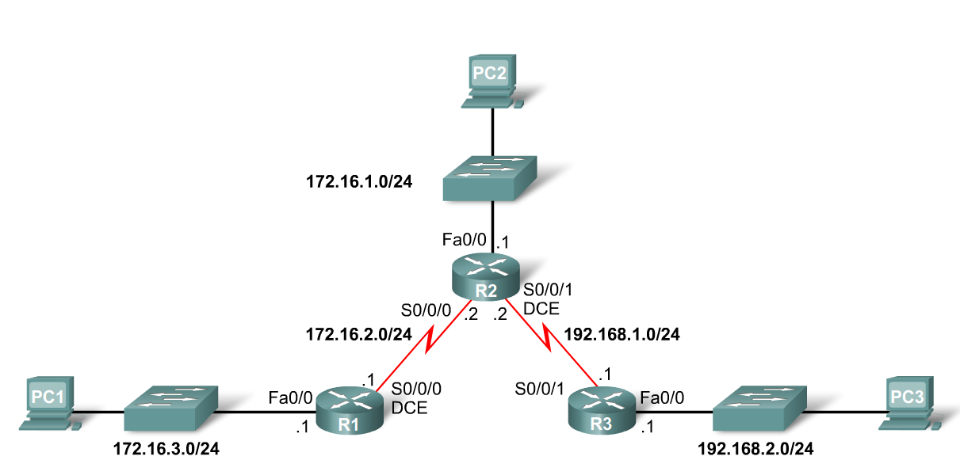
Configure STATIC
Use the following commands for R1
R1(config)# ip route 172.16.1.0 255.255.255.0 172.16.2.2
R1(config)# ip route 192.168.1.0 255.255.255.0 172.16.2.2
R1(config)# ip route 192.168.2.0 255.255.255.0 172.16.2.2

Slide 18
Agenda
Routing in IPv4…
Dynamic Route (RIPv1)

Slide 19
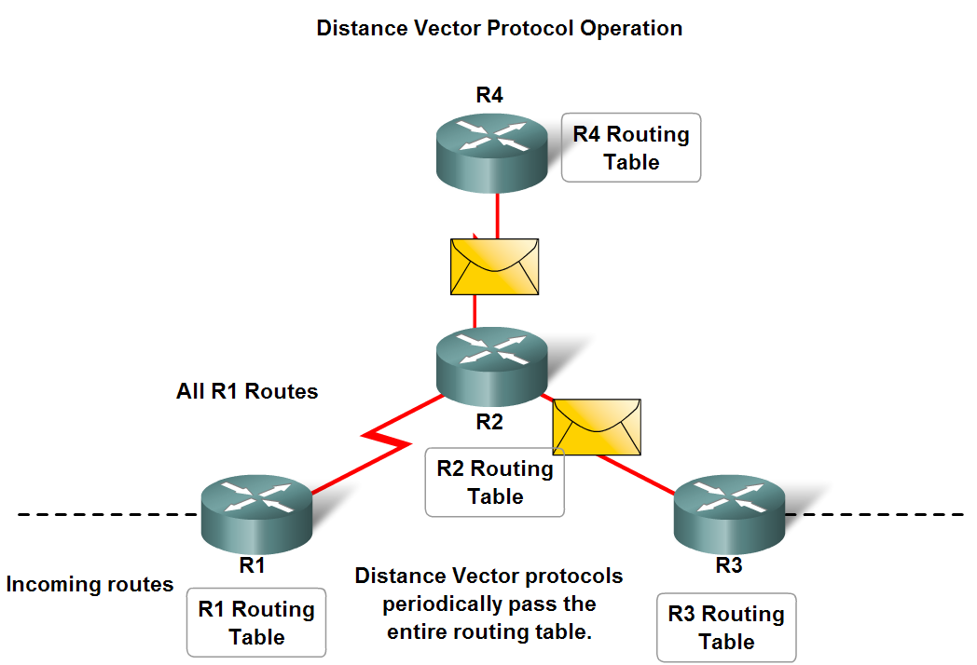
Comparison DV & LS
Distance Vector
routes are advertised as vectors
of distance & direction.
incomplete view of network
topology.
Generally, periodic
updates.
Link State
complete view of network
topology is created.
updates are not periodic.

Slide 20
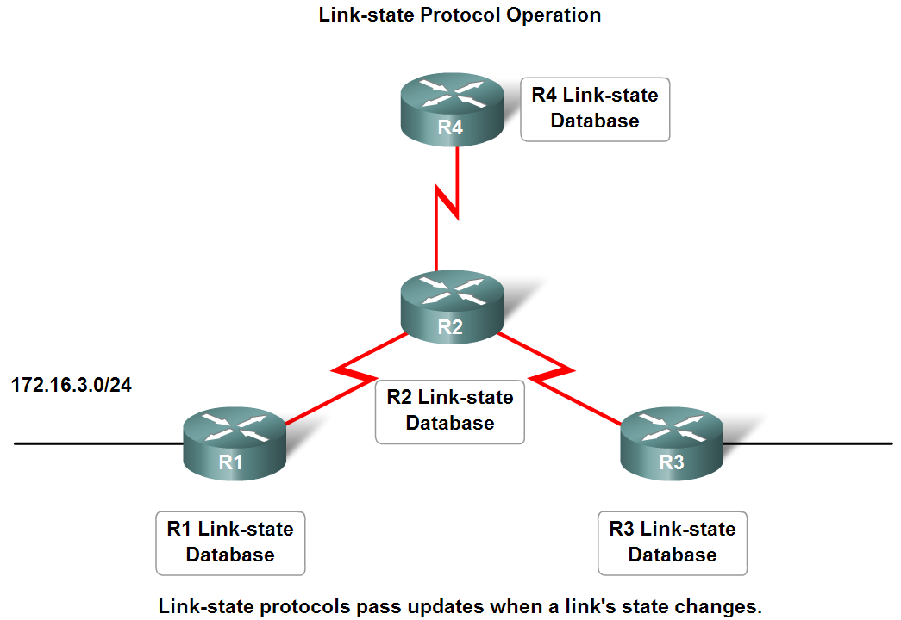
Comparison DV & LS
Distance Vector
routes are advertised as vectors
of distance & direction.
incomplete view of network
topology.
Generally, periodic
updates.
Link State
complete view of network
topology is created.
updates are not periodic.

Slide 21
RIPv1
RIP Characteristics
Distance Vector (DV) routing protocol
Metric = hop count
Routes with a hop count > 15 are unreachable
Updates are broadcast every 30 seconds
AD = 120

Slide 22
RIPv1
RIP Operation
RIP uses 2 message types:
Request message
-This is sent out on startup by each RIP enabled interface
-Requests all RIP enabled neighbors to send routing table
Response message
-Message sent to requesting router containing routing table

Slide 23
RIPv1
Router RIP Command
To enable RIP enter:
-Router rip at the global configuration prompt
-Prompt will look like
R1(config)# router rip
R1(config-router)# network net_address_1
R1(config-router)# network net_address_3
R1(config-router)# network net_address_3
Prevent RIP updates from going out an interface fa0/0
R1(config-router)# passive-interface fa0/0

Slide 24
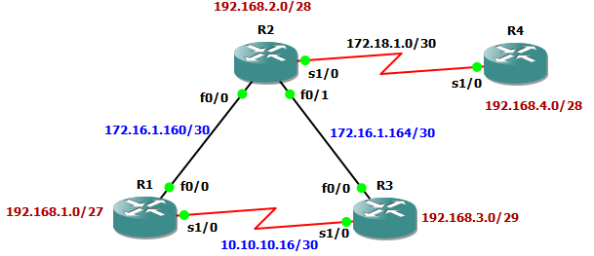
DV Example : RIPv1
R1(config)# router rip
R1(config-router)# net 192.168.1.0
R1(config-router)# net 172.16.1.160
R1(config-router)# net 10.10.10.16
R1# show ip route 172.16.0.0/30 is subnetted, 2 subnets R 172.16.1.164 [120/1] via 172.16.1.162, 00:00:09, FastEthernet0/0 C 172.16.1.160 is directly connected, FastEthernet0/0 R 172.18.0.0/16 [120/1] via 172.16.1.162, 00:00:09, FastEthernet0/0 R 192.168.4.0/24 [120/2] via 172.16.1.162, 00:00:09, FastEthernet0/0 10.0.0.0/30 is subnetted, 1 subnets C 10.10.10.16 is directly connected, Serial1/0 192.168.1.0/27 is subnetted, 1 subnets C 192.168.1.0 is directly connected, Loopback1 R 192.168.2.0/24 [120/1] via 172.16.1.162, 00:00:11, FastEthernet0/0 R 192.168.3.0/24 [120/1] via 10.10.10.18, 00:00:03, Serial1/0

Slide 25
Agenda
Routing in IPv6…
Dynamic Route (RIPv1)

Slide 26
Need IPv6…???
In IPv4 we have VLSM/CIDR and NAT.
IPv4 has only about 4.3 billion addresses available—in theory.
There really are only about 250 million addresses that can he assigned to devices.
The fact that there are about 6.5 billion people in the world today. [LAMMLE-2007]
Now, the number of people and devices that connect to networks increases each and every day.
The Next-Generation Internet Protocol – IPV6.

Slide 27
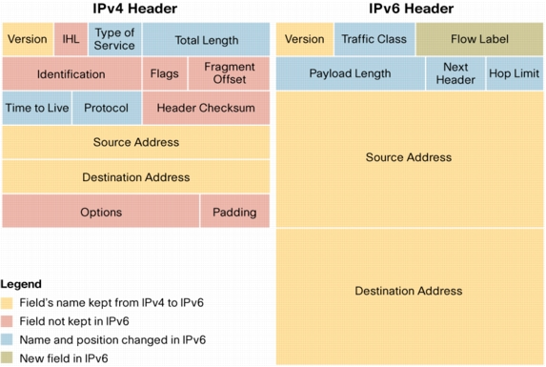
IPv4 vs IPv6

Slide 28
IPv6 is…
IPv6, formerly named IPng (next generation), is the latest version of the Internet Protocol (IP).
IP is a packet-based protocol used to exchange data, voice, and video traffic over digital networks.
IPv6 quadruples the number of network address bits from 32 bits (in IPv4) to 128 bits.

Slide 29

IPv6 Addressing
Actually 128 bits in length.
The address is expressed in hexadecimal just like a MAC address is, so you could say this address has eight 16-bit hexadecimal colon-delimited blocks.
How about HTTP connection in IPv6?

Slide 30
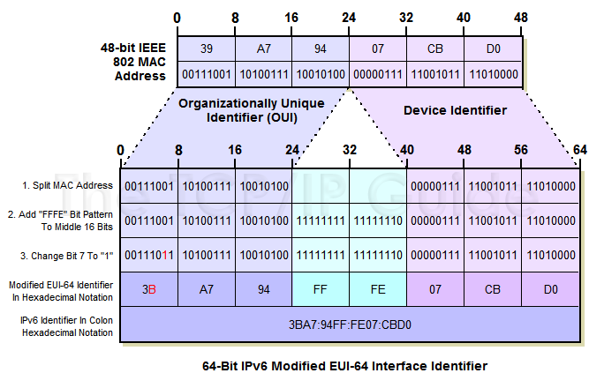
Modified EUI-64 Interface ID

Slide 31
IPv6 Addressing Examples
LAN: 3ffe:b00:c18:1::/64
Ethernet0
interface Ethernet0
ipv6 address 2001:410:213:1::/64 eui-64
MAC address: 0060.3e47.1530
router# show ipv6 interface Ethernet0
Ethernet0 is up, line protocol is up
IPv6 is enabled, link-local address is FE80::260:3EFF:FE47:1530
Global unicast address(es):
2001:410:213:1:260:3EFF:FE47:1530, subnet is 2001:410:213:1::/64
Joined group address(es):
FF02::1:FF47:1530
FF02::1
FF02::2
MTU is 1500 bytes

Slide 32
Shortened Expression
Example 1:
before = 2001:db8:3c4d:12:0:0:1234:56ab
after = 2001:db8:3c4d:12::1234:56ab
Example 2:
before = 2001:0000:0000:0012:0000:0000:1234:56ab
before = 2001::0012::1234:56ab (WRONG)
before = 2001::0012:0000:0000:1234:56ab (RIGHT)
before = 2001:0000:0000:0012::1234:56ab (RIGHT)

Slide 33
Migration Techniques
A wide range of techniques have been identified and implemented, basically falling into three categories:
(1) dual-stack techniques, to allow IPv4 and IPv6 to co-exist in the same devices and networks
(2) tunneling techniques, to avoid order dependencies when upgrading hosts, routers, or regions
(3) translation techniques, to allow IPv6-only devices to communicate with IPv4-only devices
Expect all of these to be used, in combination

Slide 34
Routing in IPv6
As in IPv4, IPv6 has 2 families of routing protocols: IGP and EGP, and still uses the longest-prefix match routing algorithm
IGP
RIPng (RFC 2080)
Cisco EIGRP for IPv6
OSPFv3 (RFC 2740)
Integrated IS-ISv6 (draft-ietf-isis-ipv6-02)
EGP : MP-BGP4 (RFC 2858 and RFC 2545)
IOS more than 12.4

Slide 35
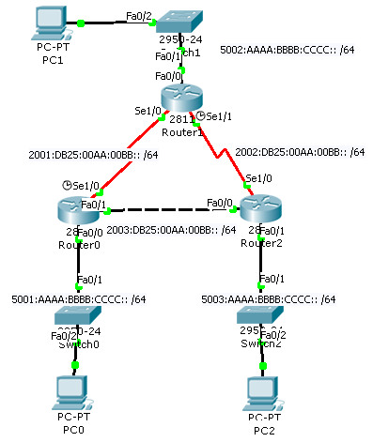
RIPng Configuration
Router0# sh run
!
ipv6 unicast-routing
!
interface FastEthernet0/0
ipv6 address 5001:AAAA:BBBB:CCCC::/64 eui-64
ipv6 rip RT0 enable
!
interface FastEthernet0/1
ipv6 address 2003:DB25:AA:BB::/64 eui-64
ipv6 rip RT0 enable
!
interface Serial1/0
no ip address
ipv6 address 2001:DB25:AA:BB::/64 eui-64
ipv6 rip RT0 enable
clock rate 9600
!
!
ipv6 router rip RT0
!

Slide 36
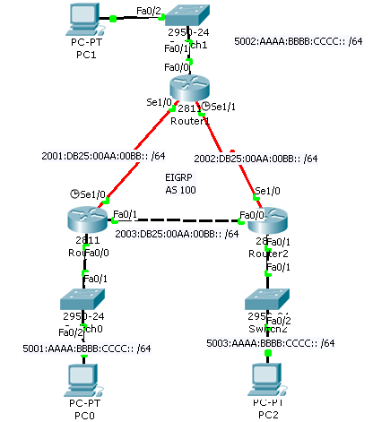
EIGRP for IPv6 Configuration
Rouyter0# sh run
!
ipv6 unicast-routing
!
interface FastEthernet0/0
ipv6 address 5001:AAAA:BBBB:CCCC::/64 eui-64
ipv6 eigrp 100
ipv6 enable
!
interface Serial1/0
no ip address
ipv6 address 2001:DB25:AA:BB::/64 eui-64
ipv6 eigrp 100
ipv6 enable
clock rate 9600
!
!
ipv6 router eigrp 100
router-id 1.1.1.1
no shutdown
!

Slide 37
OSPFv3 Configuration
Router1#
interface Ethernet0
ipv6 address 2001:1:1:1::1/64
ipv6 ospf 1 area 0
interface Ethernet1
ipv6 address 2001:2:2:2::2/64
ipv6 ospf 1 area 1
ipv6 router ospf 1
router-id 1.1.1.1
area 1 range 2001:2:2::/48
Area 0
Router2
LAN1: 2001:1:1:1::/64
Eth0
Router1
Eth1
LAN2: 2001:2:2:2::/64
Area 1

Slide 38
Chapter 3 ~ Routing ~
Thank You ☺
Gandeva Bayu Satrya, ST., MT.

